Slide 1


PANIMALAR ENGINEERING COLLEGE
(An Autonomous Institution, Affiliated to Anna University, Chennai)
Department of Computer Science and Engineering
CS8811 PROJECT WORK
OPTIMAL FEATURE SELECTION TO PREDICT RENAL CELL CARCINOMA
USING DEEP LEARNING ALGORITHMS
Project Guide: Mr. M.MOHAN, B.E, M.Tech.,(Ph.D.)
ASSISTANT PROFESSOR
GRADE 1
Rahul S -211419104209
Sai Kumar M - 211419104226
Tarun V - 211419104288
Batch Number : C3

Slide 2
Introduction
Kidney cancer is among the 10 most common cancers in both men and women. Overall, the lifetime risk for developing kidney cancer in men is about 1 in 46 (2.02%). The natural history of renal cell carcinoma (RCC) is highly unpredictable and challenging. Current diagnosis of renal cancer consists of histopathologic examination of tissue sections and classification into tumor stages and grades of malignancy. We aimed to develop an improved cancer prediction system by using the deep learning techniques, which automates the classification of Renal Cell Carcinoma Levels and also for identification of features using histopathological images. We trained and validated Graph neural networks (GNN’s) on whole-slide images to distinguish Renal Cell Carcinoma from normal tissue with comparatively improved classification accuracy.

Slide 3
Literature Survey
SNO | AUTHORS | TITLE | LINK | YEAR
1 | Nathan Hadjiyski, Ann Arbor [1]et al | Kidney Cancer Staging: Deep Learning Neural Network Based Approach | https://ieeexplore.ieee.org/document/9280188 | 2020
2 | Guozhen Chen, Chenguang Ding, Yang Li, Xiaojun Hu, Xiao Li, Li Ren, Xiaoming Ding, Puxun Tian, Wujun Xue [2]et al | Prediction of Chronic Kidney Disease Using Adaptive Hybridized Deep Convolutional Neural Network on the Internet of Medical Things Platform. | https://ieeexplore.ieee.org/document/9094581 | 2020

Slide 4
Literature Survey
SNO | AUTHORS | TITLE | LINK | YEAR
3 | Ahmed Elmahy, Sherin Aly, Fayek Elkhwsky [3]et al | Cancer Stage Prediction From Gene Expression Data Using Weighted Graph Convolution Network | https://ieeexplore.ieee.org/document/9590177 | 2021
4 | Dong Liu; Jinkai Shao; Honggang Liu; Wei Cheng [4]et al | Design on Early Warning System for Renal Cancer Recurrence Based on CNN-Based Internet of Things | https://ieeexplore.ieee.org/document/9541373 | 2022

Slide 5
Literature Survey
SNO | AUTHORS | TITLE | LINK | YEAR
5 | Christopher Ricketts, Aguirre Andres De Cubas, [5]et al | The Cancer Genome Atlas Comprehensive Molecular Characterization of Renal Cell Carcinoma | https://ieeexplore.ieee.org/document/9590177 | 2021
6 | Nicolas Coudray, Paolo Santiago Ocampo, Theodore Sakellaropoulos, Navneet Narula, Matija Snuderl, David Fenyö, Andre L Moreira, Narges Razavian, Aristotelis Tsirigos [6]et al | Classification and mutation prediction from non-small cell lung cancer histopathology images using deep learning | https://ieeexplore.ieee.org/document/9541373 | 2022

Slide 6
Literature Survey
SNO | AUTHORS | TITLE | LINK | YEAR
7 | Jun Cheng, Jie Zhang [7]et al | Classification and mutation prediction from non-small cell lung cancer histopathology images using deep learning | https://ieeexplore.ieee.org/document/9590177 | 2021
8 | Murari Lal Dhanetwal, Sonia Badwal, Gaurav Pratap Singh Gahlot, Kavita Sahai, A K Shukla [8]et al | Immunohistological Diagnosis of Primary and Metastatic Renal Cell Carcinoma Using Panel of Immunohistochemical Markers | https://ieeexplore.ieee.org/document/9541373 | 2022

Slide 7
Literature Survey
SNO | AUTHORS | TITLE | LINK | YEAR
9 | Yun Liu, Krishna Gadepalli, Mohammad Norouzi, George E. Dahl, Timo Kohlberger, Aleksey Boyko, Subhashini Venugopalan, Aleksei Timofeev, Philip Q. Nelson, Greg S. Corrado, Jason D. Hipp, Lily Peng, Martin C. Stumpe [9]et al | Detecting Cancer Metastases on Gigapixel Pathology Images | https://ieeexplore.ieee.org/document/9590177 | 2021
10 | Pegah Khosravi, Ehsan Kazemi, Marcin Imielinski, Olivier Elemento, Iman Hajirasouliha [10]et al | Deep Convolutional Neural Networks Enable Discrimination of Heterogeneous Digital Pathology Images | https://ieeexplore.ieee.org/document/9541373 | 2022

Slide 8
Problem Statement
Early detection of cancer is important because when abnormal tissue is found early, it may be easier to treat. By the time symptoms appear, cancer may have begun to spread and be harder to treat. In existing system patient-derived Xenografts, several models were developed for renal cell carcinoma and support vector machines. Hence it has some certain limitations within. Some existing systems could not produce results with more accuracy which can be leading to miscalculations. Whereas in proposed system use of Histological images help us gain a better understanding of cell behavior and reproduction, making them simpler and understandable. Graph neural networks (GNN’s) trained on whole-slide images to distinguish clear cell and chromophobe RCC from normal tissue with comparatively higher classification accuracy. With the motto of enhancing the prediction accuracy of pan renal cancer using the images of abnormal cells, we're exclusively training a deep learning algorithm with huge data set that could improve the quality of prediction compared to the existing system.

Slide 9
Development Environment
Hardware Specification
Hard Disk : 128 GB or above
Processor : Core2duo
GB RAM : 2 GB or more
Software Specification
Operating system : Windows 7 & above
Interface : Jupyter Notebook, Anaconda Distribution
Coding Language : Python
Dataset : Kaggle

Slide 10
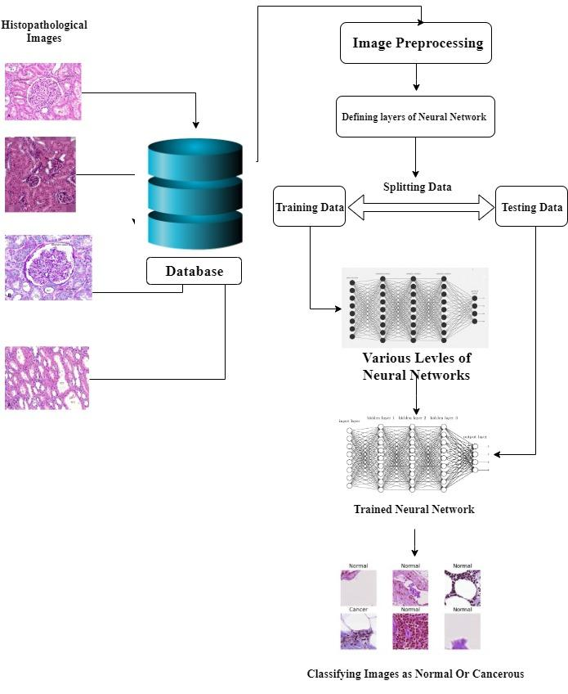
System Architecture

Slide 11
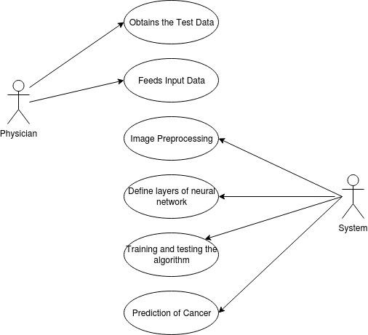
System Design
Use case Diagram

Slide 12
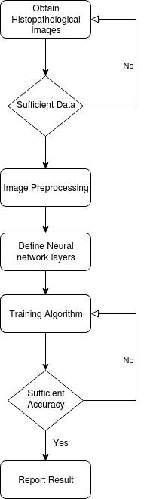
System Design
Activity Diagram

Slide 13
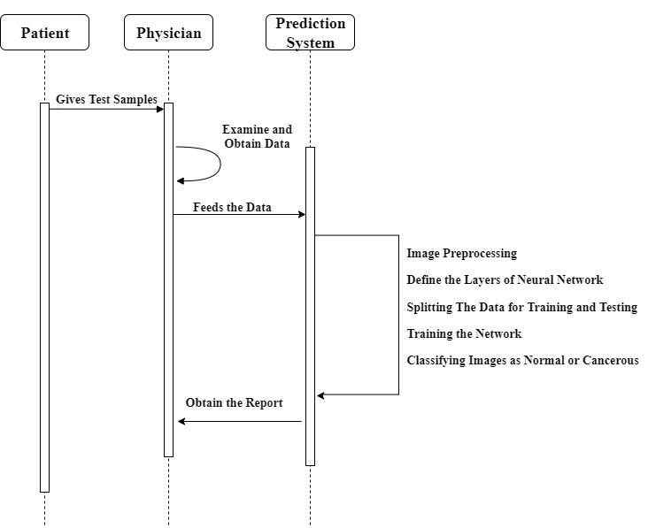
System Design
Sequence Diagram

Slide 14
System Implementation
Data Collection :
We collected the RCC patient's histopathological images dataset from Kaggle database.The dataset consists of 160,000 full sized histopathological images without kernel crash. We divided the dataset into training, validation, and testing sets with a ratio of 70:15:15.
GNN :
We used the graph neural network (GNN) to identify the most relevant features for RCC. GNN is a neural network that can operate on graph data such as molecular structures, social networks, and brain connectivity maps. In our study, we represented the RCC dataset as a graph, where each patient is a node, and the features are the edges. We used the GNN to learn the feature importance and select the top features that contribute the most to the outcome prediction. We used the Graph Attention Network (GAT) as the GNN model because of its high performance in graph-based learning tasks.

Slide 15
System Implementation
Image Preprocessing :
Image preprocessing refers to the various operations and techniques that are performed on an image before it is used as input for a machine learning algorithm or computer vision system. Histopathological images are obtained using the microscopic examination of a biopsy of a surgical specimen which is processed and fixed onto glass slides for analysis. ImageDataGenerator is a class in the Keras library that provides a way to augment image data during the training process for deep learning models. It allows you to apply various data augmentation techniques, such as rotation, zooming, shifting, flipping, and normalization to your input images.
Creation of Directories :
We are creating a new directory named "base_dir". Then, we create two new directories named "train_dir" and "val_dir" inside "base_dir". These directories will be used to store our training and validation data for our model. The directories are named after the class labels, which are "no_tumor_tissue" and "has_tumor_tissue".

Slide 16
System Implementation
Training and Validation:
Model.h5 is a training model which defines and trains a graph neural network to classify images of histopathologic tissue samples into two classes (whether a sample has tumor tissue or not). First, the code reads a CSV file with information about the images and it creates two lists of image IDs for training and validation sets. Next, the code creates the directory structure for the train and validation sets, and copies the corresponding image files into their respective folders based on the labels (0 or 1). Then it defines a graph neural network using the Keras Sequential model. Lastly, we train the model using the training and validation generators created using Keras ImageDataGenerator class. It saves the best model based on the validation accuracy and reduces the learning rate if the validation accuracy doesn't improve for 2 epochs.

Slide 17
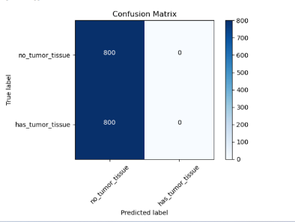
System Implementation
Confusion Matrix:
A confusion matrix can be used to evaluate the performance of a graph neural network (GNN) for predicting renal cell carcinoma (RCC) based on input data. In this case, the GNN would take as input graphs representing the RCC tissues, and output a prediction for each graph, indicating whether or not it is malignant. The confusion matrix can be used to evaluate the performance of the GNN by comparing its predictions to the true labels of the RCC tissues. Specifically, the confusion matrix would show the counts of true positives, true negatives, false positives, and false negatives for the GNN's predictions. The use of a confusion matrix in this context is important because RCC is a disease that is difficult to diagnose accurately using traditional methods, and misdiagnosis can have serious consequences for patients. By using a GNN and evaluating its performance using a confusion matrix, we can better understand how well the GNN is able to accurately predict RCC, which can be used to guide improvements to the model and ultimately improve diagnosis and treatment outcomes for patients.

Slide 18
System Implementation
Testing :
We create a "test_images" directory by listing the contents of the "test_dir" directory. And then, We are testing the dataset images using the Model.h5 AI model. Testing images has no labels and hence the model.h5 model has to predict the cancer images using the trained data. Using the AI model we totally test around 56719 unlabeled images. Hence we predicted and separated the images which has tumor and non tumor cells.
Predictions :
Here we generate predictions for test images using a trained model. It classifies each image into one of four categories - normal, Stage 1, Stage 2, and Critical - based on the predicted probability of having tumor tissue. It creates a new column called stages in the submission dataframe and assigns each image to one of the four categories based on the predicted probability. Finally, it displays 4 sample images from each category using matplotlib.pyplot.

Slide 19
System Implementation
Accuracy :
The accuracy of the predicted unlabelled testing images can be calculated through Area Under the ROC Curve(AUC). The AUC of 96% for training was obtained. This AI system shows a great promise for physicians and doctors trying to treat renal cell carcinoma.

Slide 20
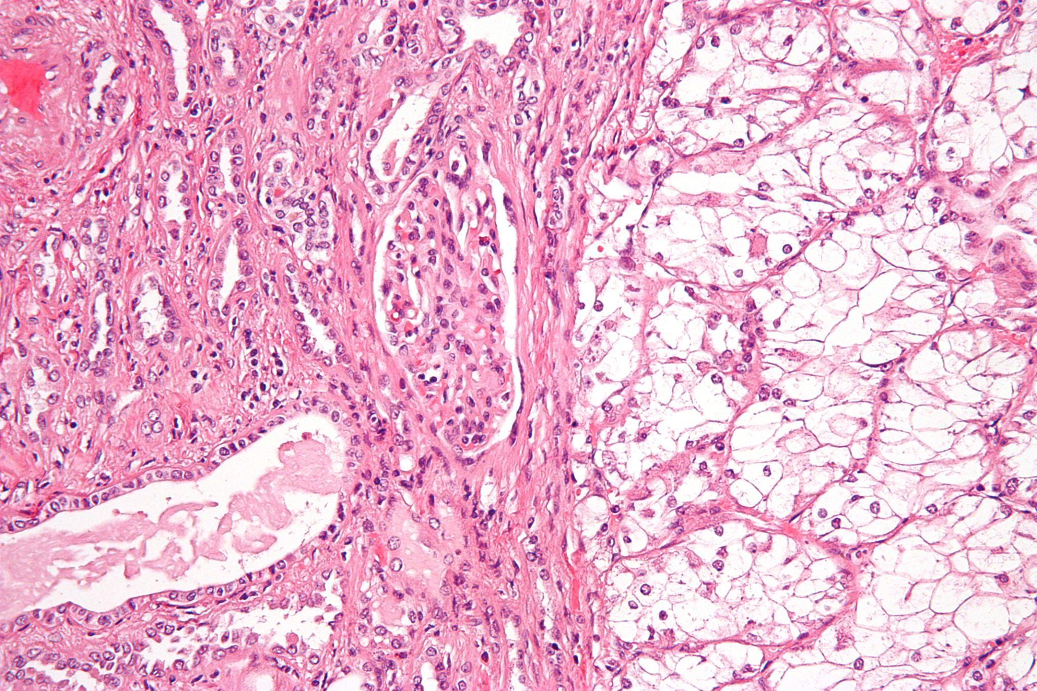
Test cases and Reports
TEST CASE ID : 1
TEST CASE / ACTION TO BE PERFORMED : Image with clear cell renal cell carcinoma (ccRCC)
INPUT : A histology image of a kidney tumor with clear cell renal cell carcinoma.
OUTPUT : The model predicts a high likelihood of ccRCC based on the characteristics of the tumor in the image, such as the presence of clear cells and a distinct pattern of tumor cells.
PASS/ FAIL : Pass

Slide 21
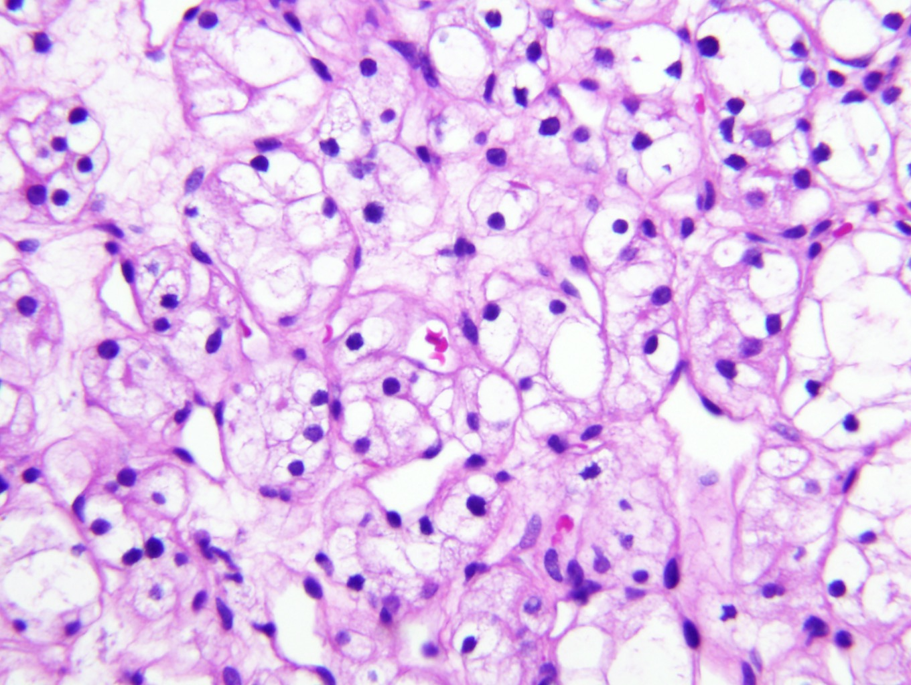
Test cases and Reports
TEST CASE ID : 2
TEST CASE / ACTION TO BE PERFORMED : Image with non-cancerous renal cells
INPUT : A histology image of a healthy kidney tissue sample.
OUTPUT : The model predicts a low likelihood of renal cell carcinoma, as the image does not show any signs of cancerous cells.
PASS/ FAIL : Pass

Slide 22
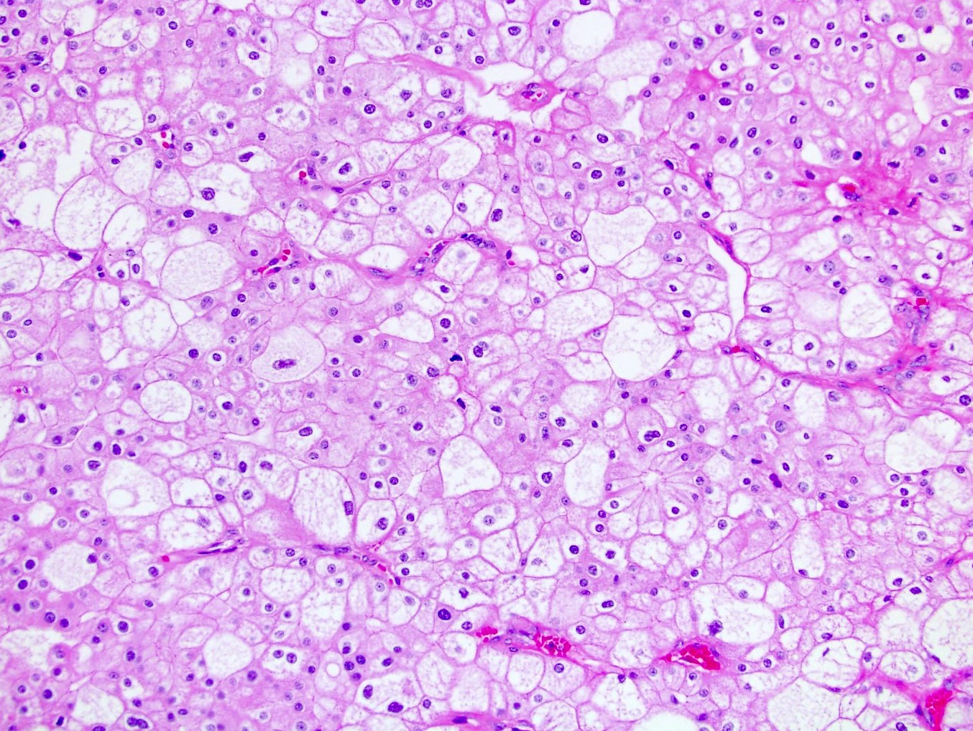
Test cases and Reports
TEST CASE ID : 3
TEST CASE / ACTION TO BE PERFORMED : Image with mixed renal cell carcinoma subtypes
INPUT : A histology image of a kidney tumor with a mixture of different renal cell carcinoma subtypes.
OUTPUT : The model predicts a moderate to high likelihood of renal cell carcinoma, depending on the predominant subtype(s) present in the image and the specific features of the tumor cells.
PASS/ FAIL : Pass

Slide 23
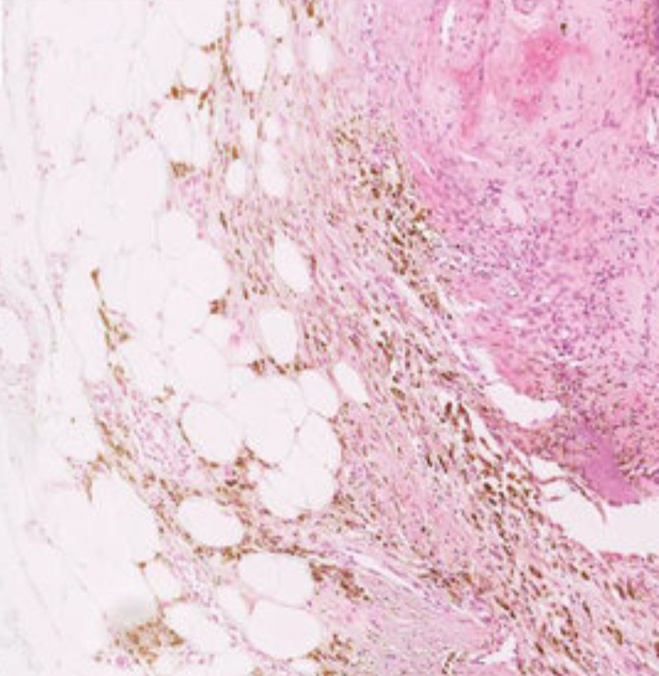
Test cases and Reports
TEST CASE ID : 4
TEST CASE / ACTION TO BE PERFORMED : Image with unclear tumor boundaries
INPUT : A histology image of a kidney tumor with poorly defined boundaries
OUTPUT : The model may have difficulty accurately predicting the likelihood of renal cell carcinoma in this case, as the boundaries between the tumor and surrounding tissue are unclear.
PASS/ FAIL : Pass

Slide 24
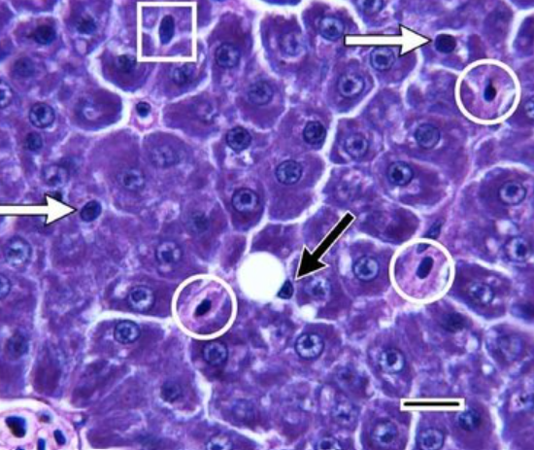
Test cases and Reports
TEST CASE ID : 5
TEST CASE / ACTION TO BE PERFORMED : Image with artifacts or staining anomalies
INPUT : A histology image of a kidney tumor with staining artifacts or other anomalies that could affect image quality
OUTPUT : The model may produce inaccurate results if the artifacts or anomalies in the image interfere with its ability to accurately identify and classify renal cell carcinoma cells.
PASS/ FAIL : Pass

Slide 25
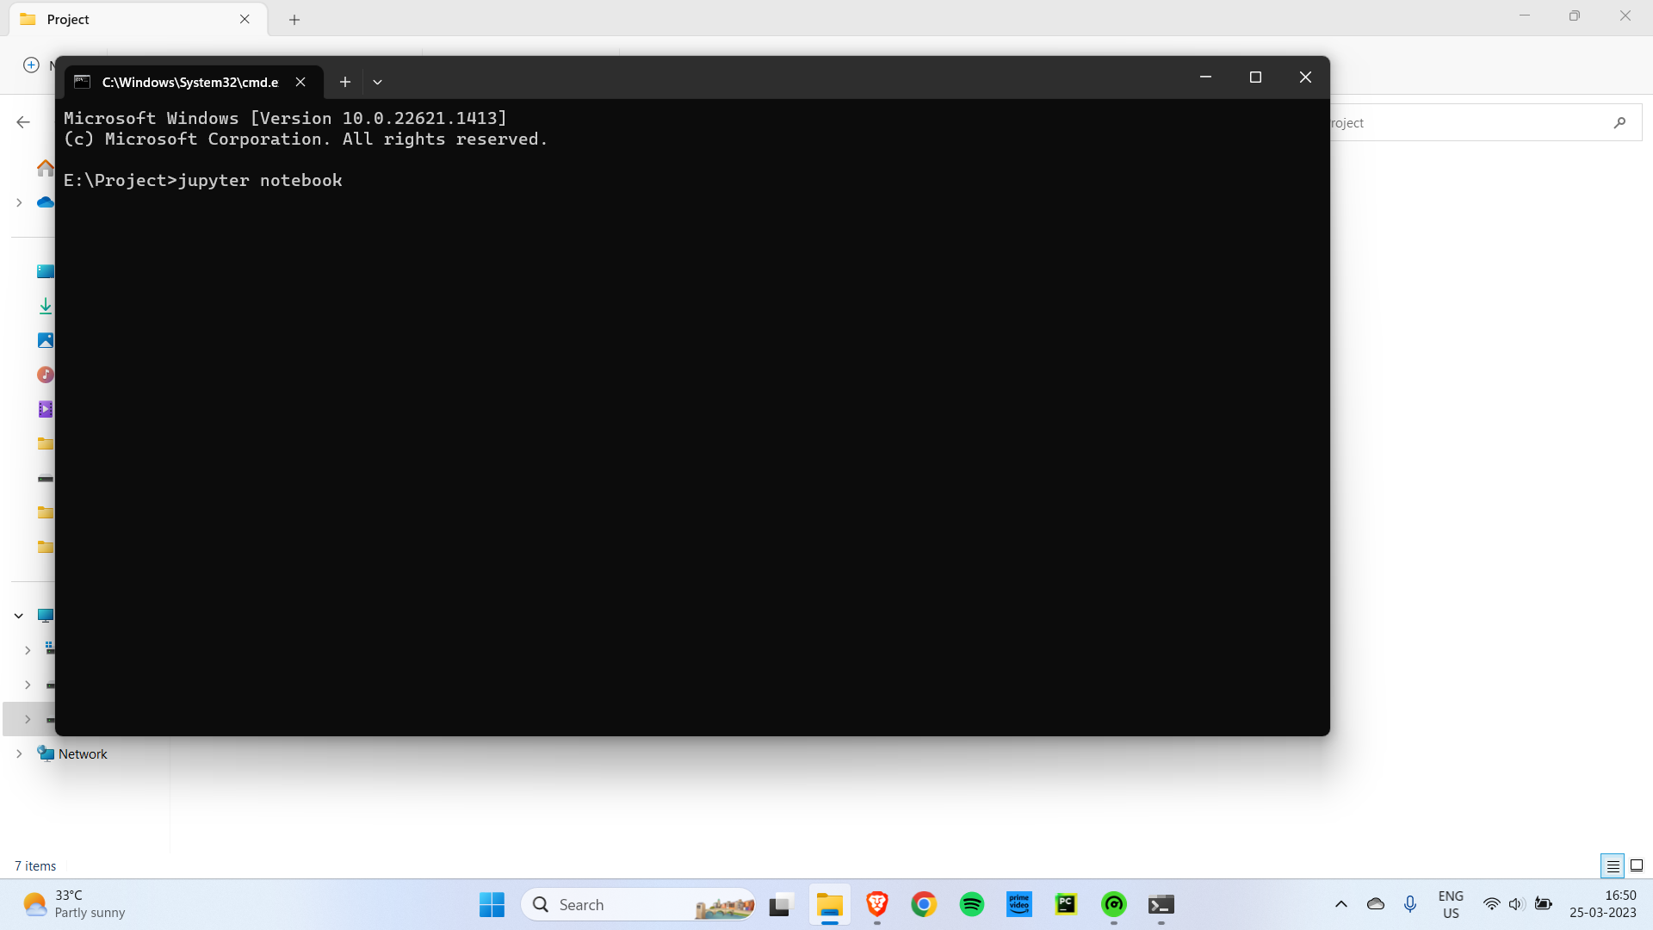
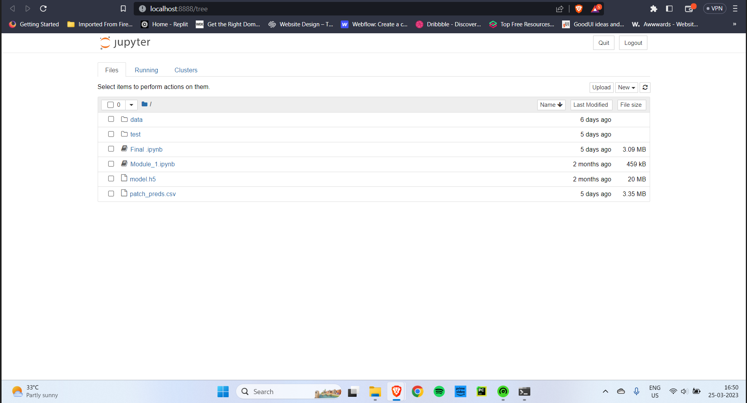
Screenshots

Slide 26
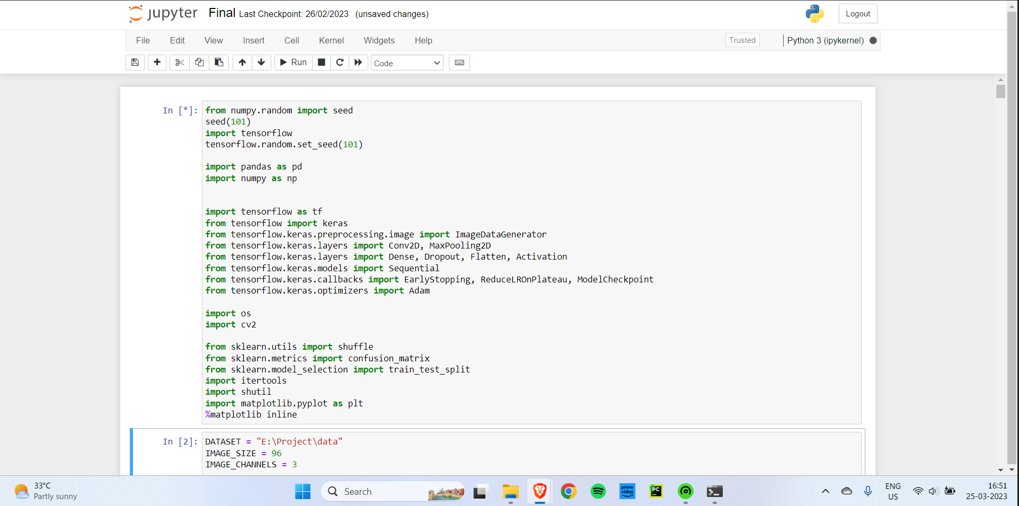
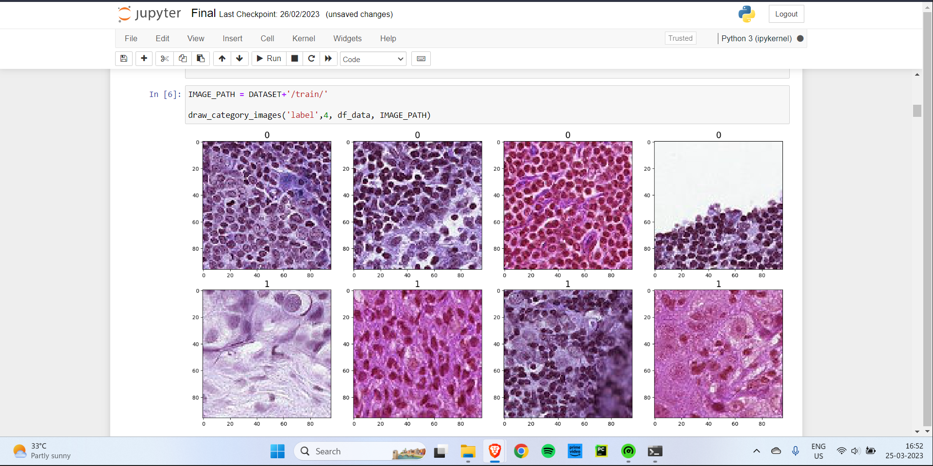
Screenshots

Slide 27
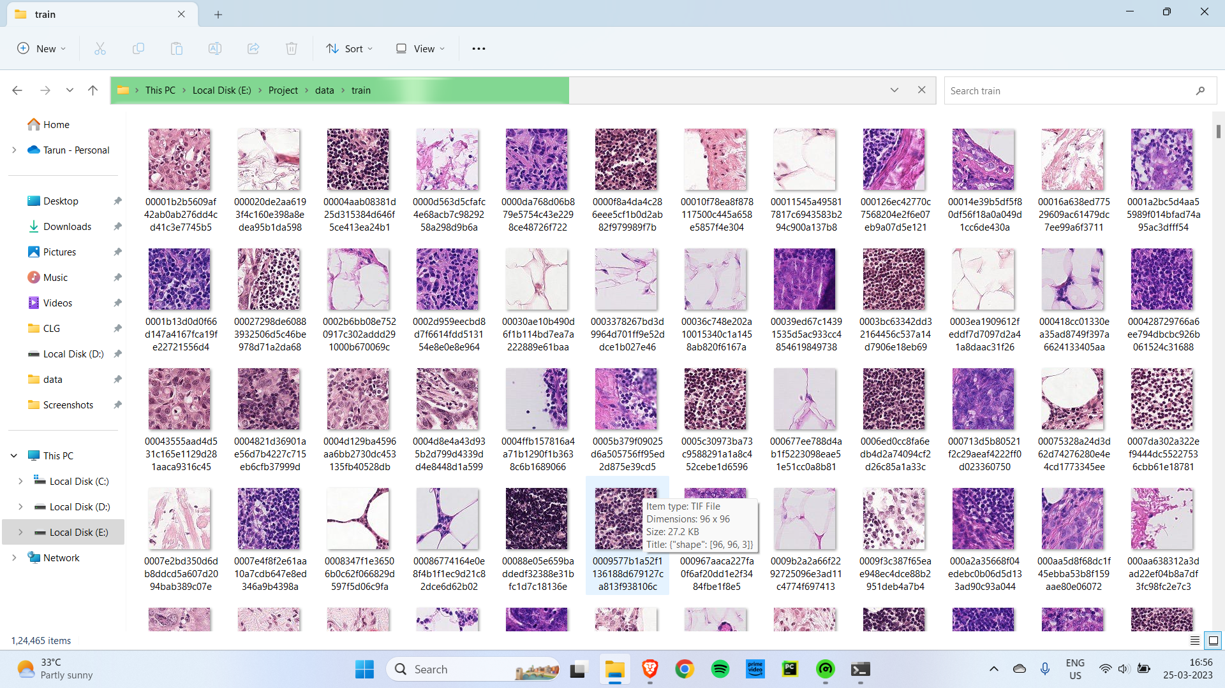
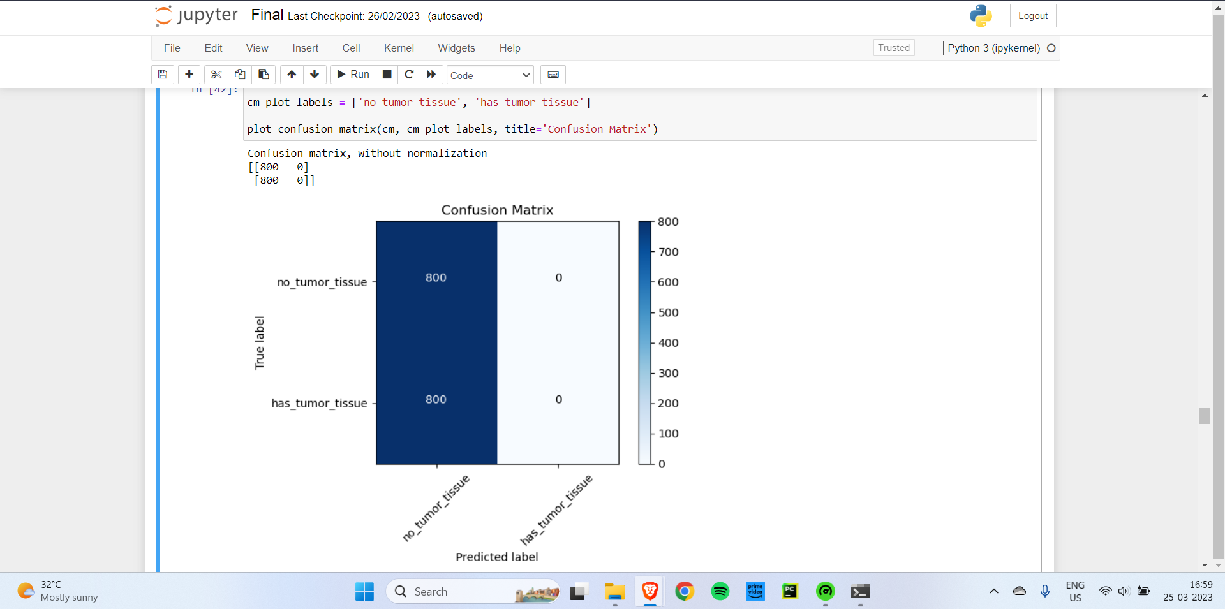
Screenshots

Slide 28
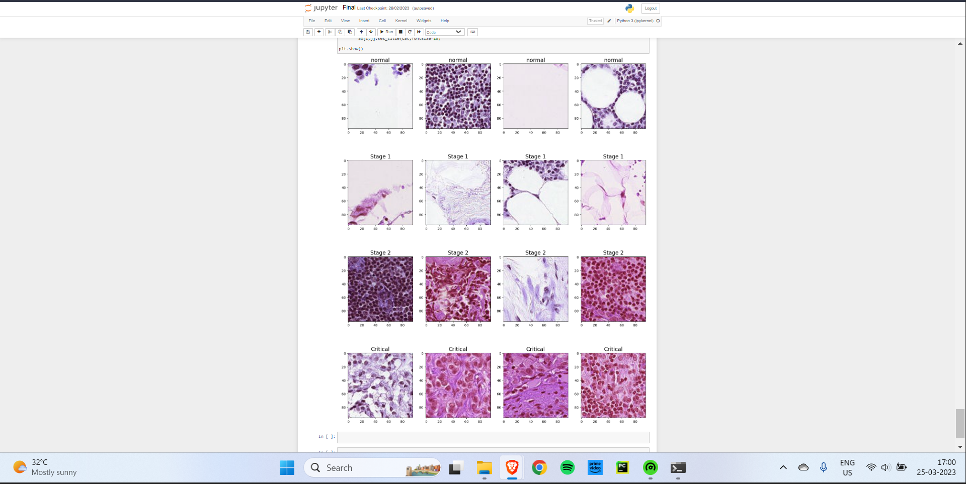
Screenshots

Slide 29
Conclusion
This system presented a heuristic approach using deep learning algorithms so as to build a classification model for monitoring the tumor stage progression in RCC based on histopathological images. This system works based on an optimized algorithm which is generally not programmed with any task-specific rules. A Neural network model is constructed to perform the diagnosis of renal cell carcinoma progression in patients. The major advantage of this system is that it is responsible for analysing the data with preloaded input to detect the accurate result with greater performance and consume a less amount of time in processing and predicting the results. Hence it helps doctors in starting the treatments early for the patients and also it helps in diagnosing more patients within a shorter period of time. We anticipate that this prediction models based on the histopathological images could contribute to the optimal management of patients in ccRCC.

Slide 30
References
[1]Nathan Hadjiyski, Kidney Cancer Staging: Deep Learning Neural Network Based Approach (2020)
[2]Guozhen Chen, Chenguang Ding, Yang Li, Xiaojun Hu, Xiao Li, Li Ren, Xiaoming Ding, Puxun Tian, Wujun Xue : Prediction of Chronic Kidney Disease Using Adaptive Hybridized Deep Convolutional Neural Network on the Internet of Medical Things Platform (2020)
[3]Ahmed Elmahy, Sherin Aly, Fayek Elkhwsky : Cancer Stage Prediction From Gene Expression Data Using Weighted Graph Convolution Network (2021)
[4]Dong Liu; Jinkai Shao; Honggang Liu; Wei Cheng : Design on Early Warning System for Renal Cancer Recurrence Based on CNN-Based Internet of Things (2021)

Slide 31
References
[5]Christopher Ricketts, Aguirre Andres De Cubas : The Cancer Genome Atlas Comprehensive Molecular Characterization of Renal Cell Carcinoma (2018)
[6]Nicolas Coudray, Paolo Santiago Ocampo, Theodore Sakellaropoulos, Navneet Narula, Matija Snuderl, David Fenyö, Andre L Moreira, Narges Razavian, Aristotelis Tsirigos : Classification and mutation prediction from non-small cell lung cancer histopathology images using deep learning (2018)
[7]Jun Cheng, Jie Zhang : Classification and mutation prediction from non-small cell lung cancer histopathology images using deep learning (2017)

Slide 32
References
[8]Murari Lal Dhanetwal, Sonia Badwal, Gaurav Pratap Singh Gahlot, Kavita Sahai, A K Shukla : Immunohistological Diagnosis of Primary and Metastatic Renal Cell Carcinoma Using Panel of Immunohistochemical Markers (2019)
[9]Yun Liu, Krishna Gadepalli, Mohammad Norouzi, George E. Dahl, Timo Kohlberger, Aleksey Boyko, Subhashini Venugopalan, Aleksei Timofeev, Philip Q. Nelson, Greg S. Corrado, Jason D. Hipp, Lily Peng, Martin C. Stumpe
Detecting Cancer Metastases on Gigapixel Pathology Images (2017)
[10]Pegah Khosravi, Ehsan Kazemi, Marcin Imielinski, Olivier Elemento, Iman Hajirasouliha : Deep Convolutional Neural Networks Enable Discrimination of Heterogeneous Digital Pathology Images (2018)

